Slide 1


Regional Opportunity Index
A powerful new information resource for people building healthy, prosperous, sustainable and equitable communities
Webinar: Launch of State-Wide Web-site
December 16, 2014

Slide 2

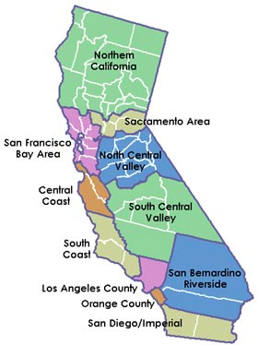


“Research that Matters for Regions”
“Dedicated to producing innovative and collaborative research to inform the building of healthy, prosperous, sustainable and equitable regions in California and beyond.”
Chris Benner, Professor
CRC Executive Committee
Sergio Cuellar
Community Engagement Coordinator

Slide 3
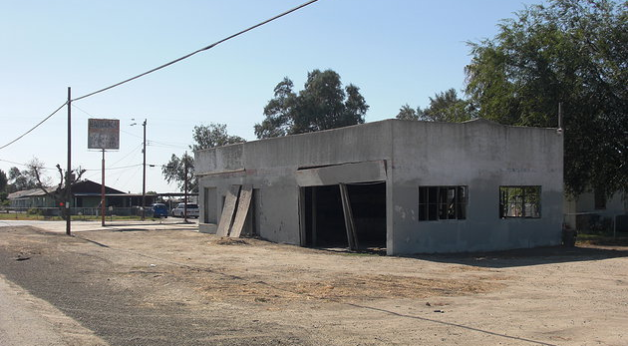
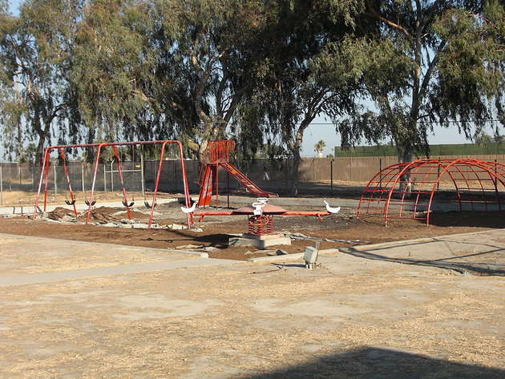
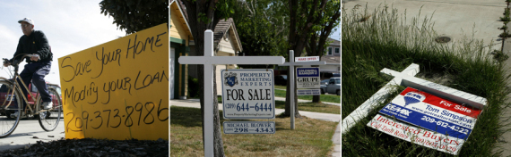

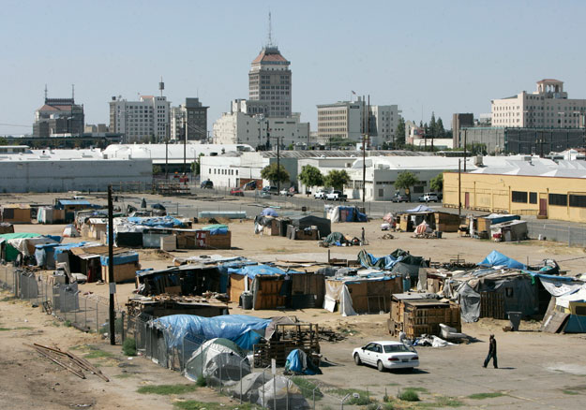

Slide 4
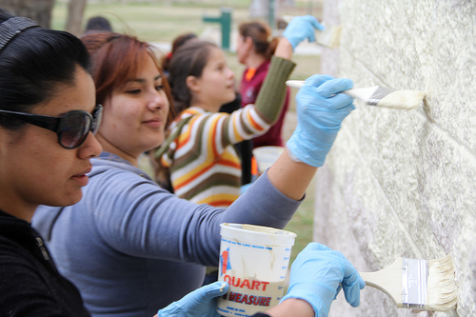
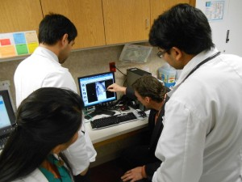
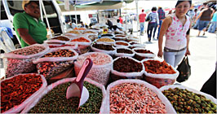

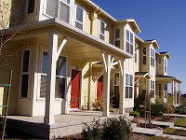

Slide 5
Comprehensive Vision of Regional Opportunity
Education
Civic Engagement
Economy
Opportunity
Transportation/ Mobility
Housing
Health/Environment
Notes:
How do domains interact at the regional scale?
What regional solutions can address these challenges?

Slide 6
Who Can Use the ROI?
Advocates
Businesses
Policy Makers
Collaboration

Slide 7
Peer Review Team
David Buchholz, Assistant Director
Division of Consumer and Community Affairs, Federal Reserve Board of Governors
Lee Beaulac, Principal
Beaulac Associates
john powell, Director
Stephen Menendian, Assistant Director
Haas Institute for a Fair and Inclusive Society, UC Berkeley
Rob Weiner, Executive Director
California Coalition for Rural Housing
Manuel Pastor, Director,
Justin Scoggins, Data Manager
Program for Environmental and Regional Equity, University of Southern California
Carolina Reid, Assistant Professor
City and Regional Planning, University of California, Berkeley
Jason Reece, Research Director
Kirwan Institute for the Study of Race & Ethnicity
The Ohio State University

Slide 8
ROI Conceptual Categories
People
Place
Education
Early Childhood learning
Adult educational attainment
Economy
Employed
Adequate Income
Housing
Home ownership
Affordability of housing expenditures
Mobility/Transportation
Close to work
Adequate transportation access
Broadband internet access
Health/Environment
Child Health
Elderly health
Social/Political Engagement
Political engagement
Civic engagement
Social Capital
Education
Quality of elementary schools
Quality of high schools
Access to adult education
Economy
Job availability
Job quality
Business growth
Access to financial services
Housing
Housing adequacy
Housing affordability
Mobility/Transportation
Quality of mass transit
Availability, quality, affordability of internet services
Health/Environment
Availability and quality of health services
Access to healthy foods
Quality of air and water
Social/Political Engagement
Residential stability and integration
Prevalence of civil society organizations

Slide 9
Indicator Selection Criteria
Availability and Currency
Geographic Scale (possible to calculate at tract level)
Reliability

Slide 10
Data Sources
U.S. Census,
ACS 5-year datasets
California Department of Education
STAR Test Results Research Files; DataQuest Expulsion, Suspension, and Truancy Report; Cohort Outcome Data; Graduates by Race and Gender; Staff Demographics
Federal Communication Commission
California Department of Public Health
Birth & Death Statistical Master Files
California Registrar of Voters
General Election Statement of Registration
National Establishment Time-Series Dataset
BLS Quarterly Census of Employment and Wages
FDIC (Federal Deposit Insurance Corporation) and NCUA (National Credit Union Association)
USDA Food Access Research Atlas
California EPA, Office of Environmental Health Hazard Assessment and Air Resources Board

Slide 11
ROI Indicators
People
Place
Education
% of adults with post-secondary education
% 4th graders proficient in ELA
% 4th graders proficient in math
Elementary school truancy rate
Economy
% of adult population employed
% of households above 200% FPL
Housing
% of households who own home
% of households paying <30% of income on housing
Mobility/Transportation
% who commute 30 min. or less
% households with at least 1 vehicle for worker
Households with broadband
Health/Environment
% healthy weight babies
% births to teens
% deaths to <75 year olds
Social/Political Engagement
% CVAP that voted in 2010
% households not linguistically isolated
Education
High school graduation rate
High school grads college ready
% elementary teachers with 5 years experience and more than BA degree
High school suspension and expulsion rate
Economy
Jobs within 5 mile radius per 1000 population
% jobs that are in high-paying industries within 5 mile radius
% job growth in last year within 5 mile radius
Banks per 1000 population within 5 mile radius
% change in number of employers within 5 mile radius, 2009-2011
Housing
% homes with <= 1 occupant per room
Ratio of median income to median home value
Health/Environment
% mothers receiving prenatal care in first trimester
% with access to full-service grocery stores
Healthcare provider locations (5 miles) per 1000 population
PM2.5 score
Social/Political Engagement
% who live in same residence as a year ago
% U.S. citizens

Slide 12
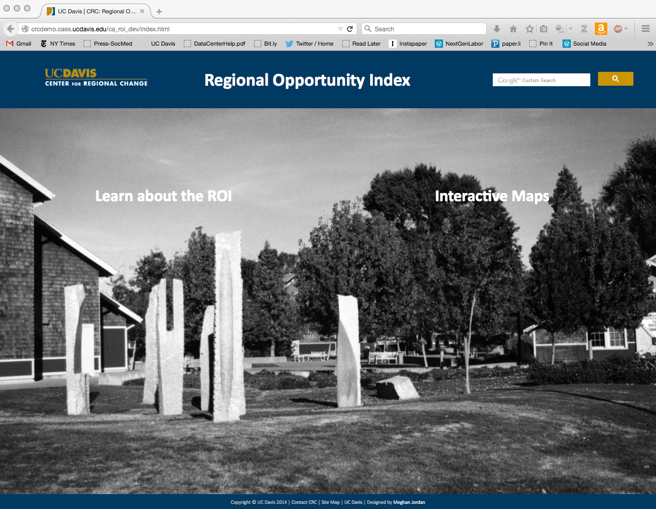

Slide 13

Youth Well-Being Index
Health
Physical fitness
Education
High school graduation
Community Involvement
Social Relationships
Positive relationships with adults and peers
Substance use avoidance
Feeling safe
University readiness
Community involvement (group participation and helping others]
Erbstein N., Hartzog, C., Geraghty, E. (2013). Putting Youth On the Map: A Pilot Instrument For Assessing Youth Well-being. Journal of Child Indicators, 6(2), 257-280.

Slide 14
Envisioning ROI 2.0⁺
Multiple years-Change over time
Custom geographies
Custom weighting
User-generated data layers/ maps
New Data
Google transit feed
Civic infrastructure
Adult education
Banking services (check cashing)
Crime
Annual Updates
Website Information
Success Stories
Tutorials
Outreach workshops
Expand geographic scope
Other states
Nation-wide

Slide 15
Thank you! http://interact.regionalchange.ucdavis.edu/roi/

